Slide 1

Coastline Prediction using Existing Climate Change Models
Emmitt Hasty
Kenny Phan

Slide 2
Introduction
Coastal cities are facing new issues as sea levels rise at faster and faster rates. As the sea levels rise, it threatens to take the homes and buildings of these coastal cities, forcing people further and further inland. This causes issues like overpopulation, as well as causing many to face hardships like homelessness and job loss.
Accurate predictions of sea level rise are very valuable to help negate these damages in two ways:
Prediction allows people to understand how the rising sea levels will affect their homes in the future, and if it may be wise for them to move further inland.
Prediction allows people to get a better picture of the affects of climate change, leading to stronger prevention efforts.

Slide 3
Data Sources
Elevation data from the United States Geological Survey
https://apps.nationalmap.gov/downloader/#/
Sea Level Rise and Coastal Flood Hazard Scenarios and Tools Interagency Task Force 2022 technical report data
Report: https://oceanservice.noaa.gov/hazards/sealevelrise/sealevelrise-tech-report-sections.html
Interactive map: https://sealevel.nasa.gov/task-force-scenario-tool
You can download the data for particular location using the map by clicking on a location -> Full Projection -> get data.
To get all the data: https://zenodo.org/record/5951626
IPCC AR6 Sea Level Projections
Report: https://www.ipcc.ch/report/ar6/wg1/
Interactive map: https://sealevel.nasa.gov/ipcc-ar6-sea-level-projection-tool
You can download the data for particular location using the map by clicking on a location -> Full Projection -> get data.
To get all the data: https://zenodo.org/record/6382554

Slide 4
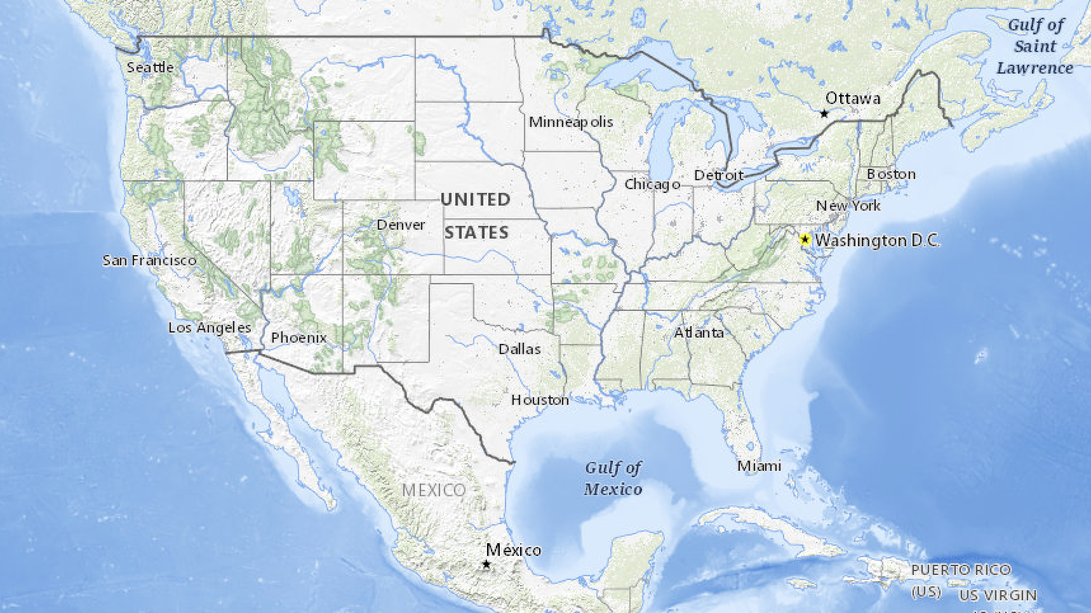
Elevation Data
Accurate to ~5m, very detailed data.

Slide 5
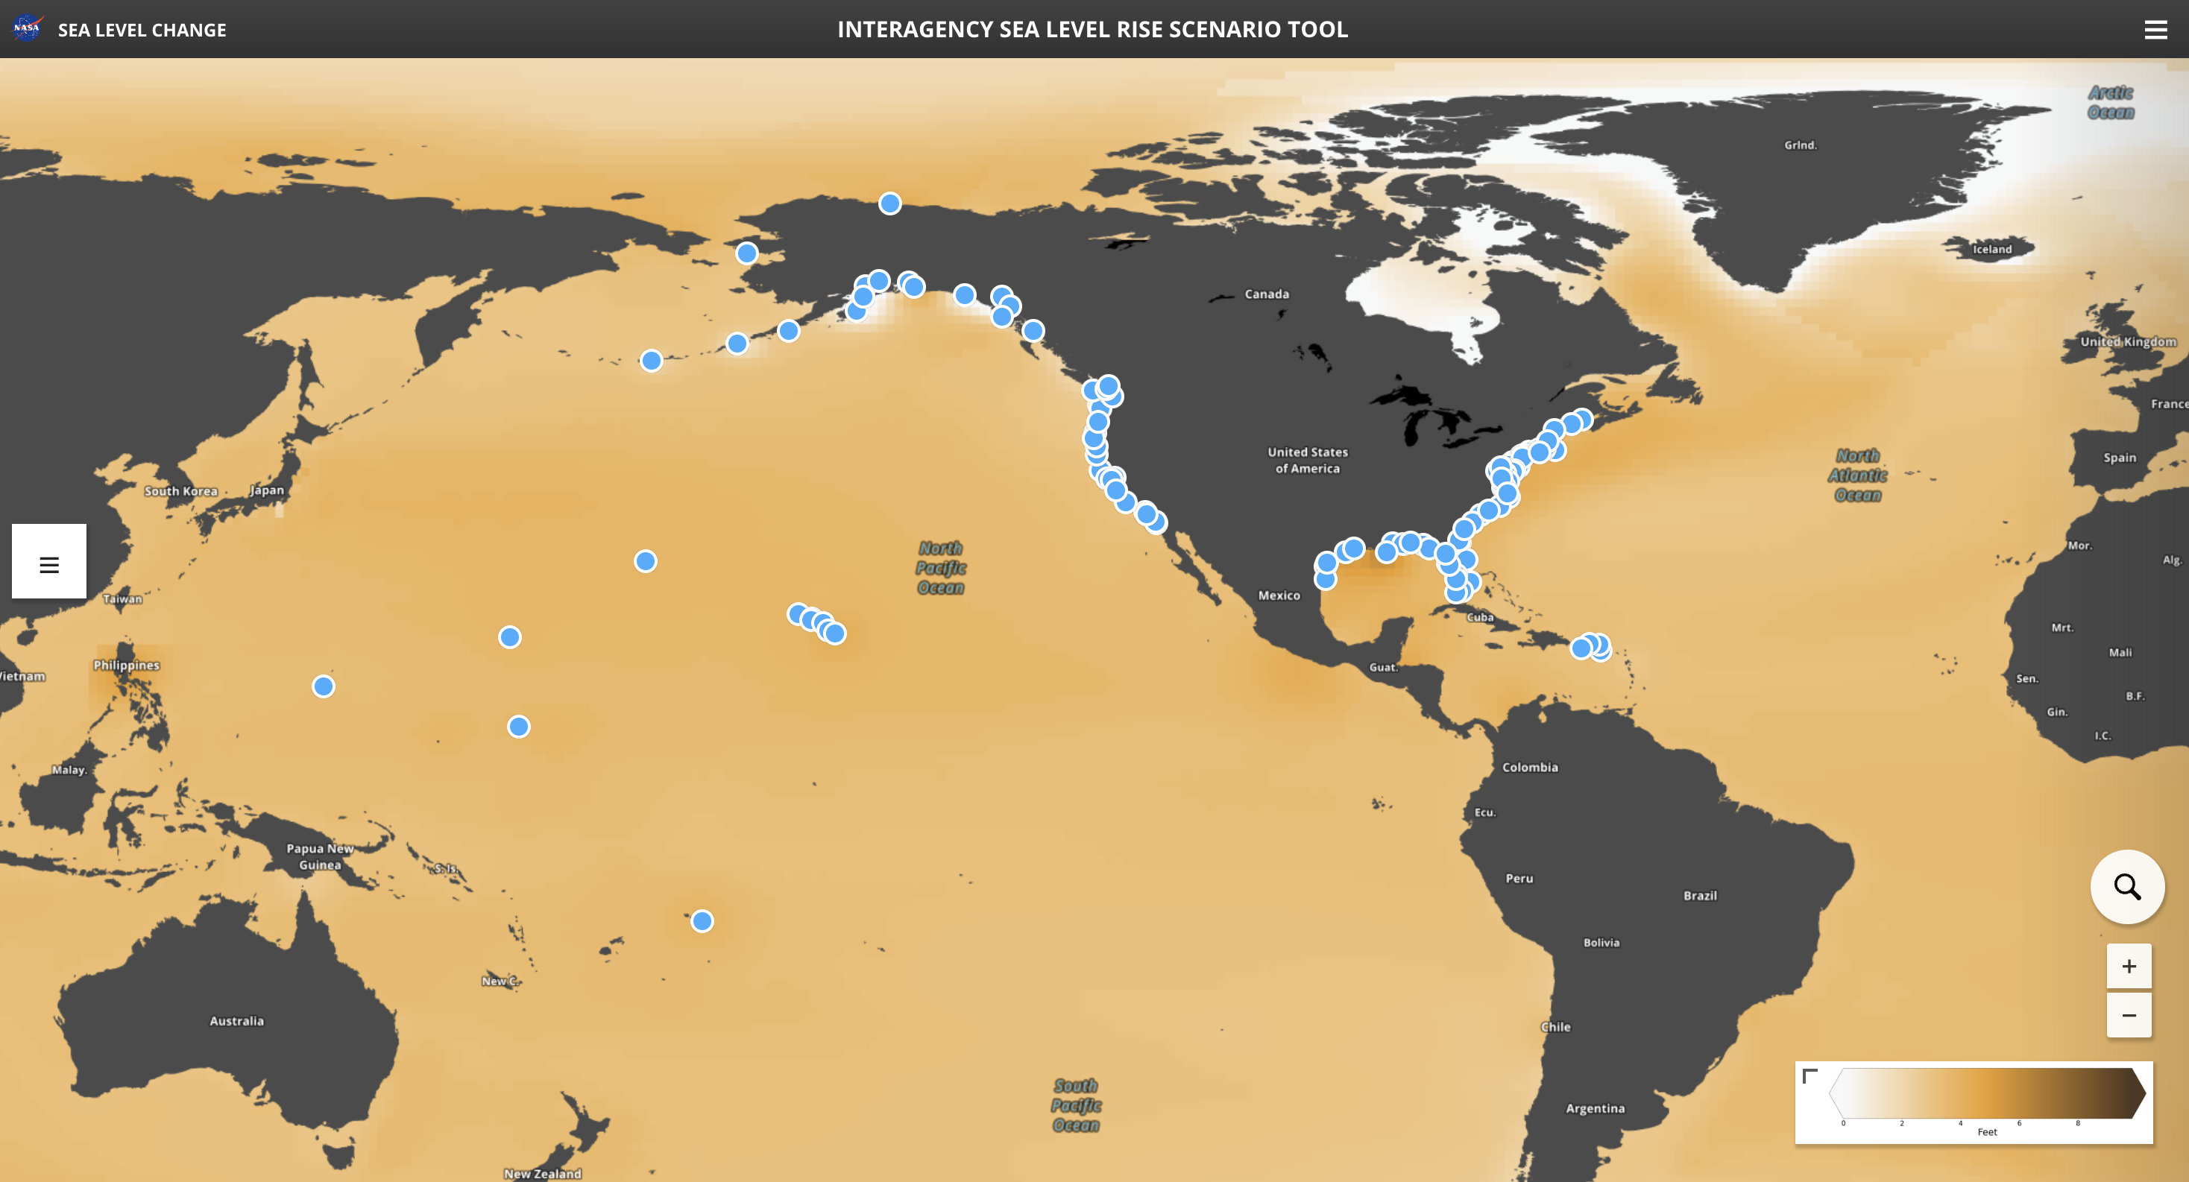
Sea Level Rise and Coastal Flood Hazard Scenarios and Tools Interagency Task Force 2022 technical report data
Good for visualization of the change, but no data points for non-US territories.

Slide 6
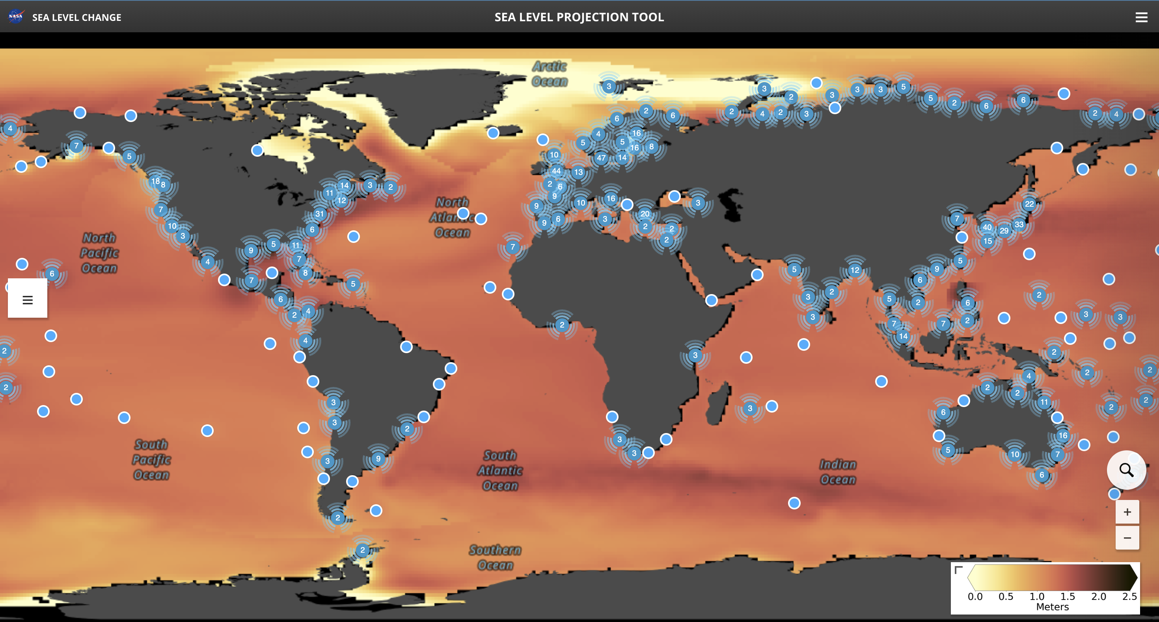
IPCC AR6 Sea Level Projections
By and large the most valuable data, contains many data points across the world for valuable visualization.

Slide 7
Methodologies
The aim of this is to use visualization software through the mapping toolbox from MATLAB, to visualize the elevation data of a local region and the sea level. From this point, we hope to develop a deep learning model to study the climate change data, as well as the current predictions as test values, to predict the changes in sea level rise for our mapped region.
This will allow us to develop a system that will be able to predict any time and any region for a user, so the user may see the areas affected that they want to see.

Slide 8
Expected Outcomes
The current data is mostly only available from about 1990, to predicted out through 2150. On top of this, for the most part there is a lack of data and prediction for nations outside of the US. The goal is to develop a system that can predict data for non-US countries, in the hopes to expand the world’s knowledge of the affects of climate change on their homes.

